Slide 1

7th Grade Math
Unit 11, Lesson 6 Representing Proportional Relationships with Equations Volume 2, pg. 175

Slide 2


Benchmarks
MA.7.AR.4.2
Determine the constant of proportionality within a mathematical or real-world context given a table, graph, or written description of a proportional relationship.
MA.7.AR.4.4
Given any representation of a proportional relationship, translate the representation to a written description, table or equation.
volume 2, pg. 175

Slide 3
Integrated Mathematical Thinking and Reasoning Standards
MA.K12.MTR.2.1 Demonstrate understanding by representing problems in multiple ways.
MA.K12.MTR.3.1 Complete tasks with mathematical fluency.
MA.K12.MTR.7.1 Apply mathematics to real-world contexts.
volume 2, pg. 175

Slide 4

Learning Targets
I can determine the constant of proportionality of a proportional relationship.
I can translate a given representation of a proportional relationship between two quantities to an equation.
volume 2, pg. 175

Slide 5

Warm-Up
volume 2, pg. 176

Slide 6

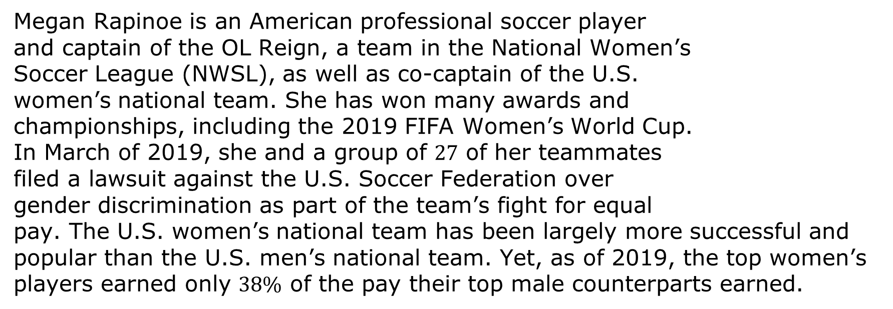
11.6.1 Warm-Up: Fighting for Equal Pay
Megan Rapinoe is an American professional soccer player and captain of the OL Reign, a team in the National Women’s Soccer League (NWSL), as well as co-captain of the U.S. women’s national team. She has won many awards and championships, including the 2019 FIFA Women’s World Cup. In March of 2019, she and a group of $27$ of her teammates filed a lawsuit against the U.S. Soccer Federation over gender discrimination as part of the team’s fight for equal pay. The U.S. women’s national team has been largely more successful and popular than the U.S. men’s national team. Yet, as of 2019, the top women’s players earned only $38\%$ of the pay their top male counterparts earned.
volume 2, pg. 176

Slide 7
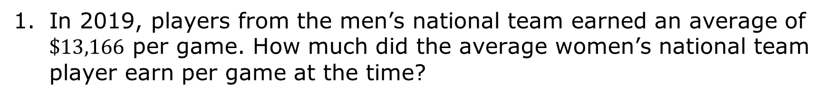
In 2019, players from the men’s national team earned an average of $\$13,166$ per game. How much did the average women’s national team player earn per game at the time?
volume 2, pg. 176

Slide 8

Exploration
volume 2, pg. 176

Slide 9

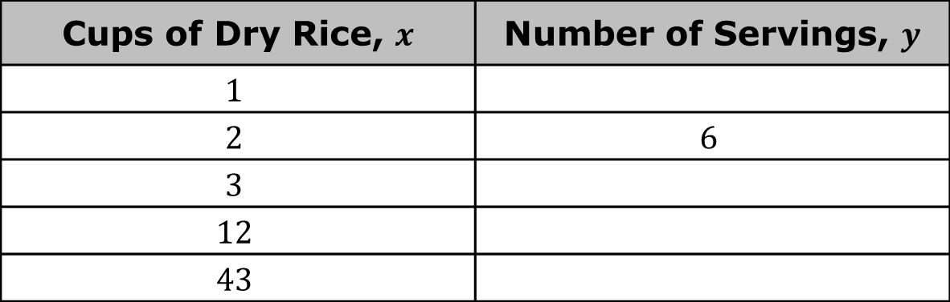
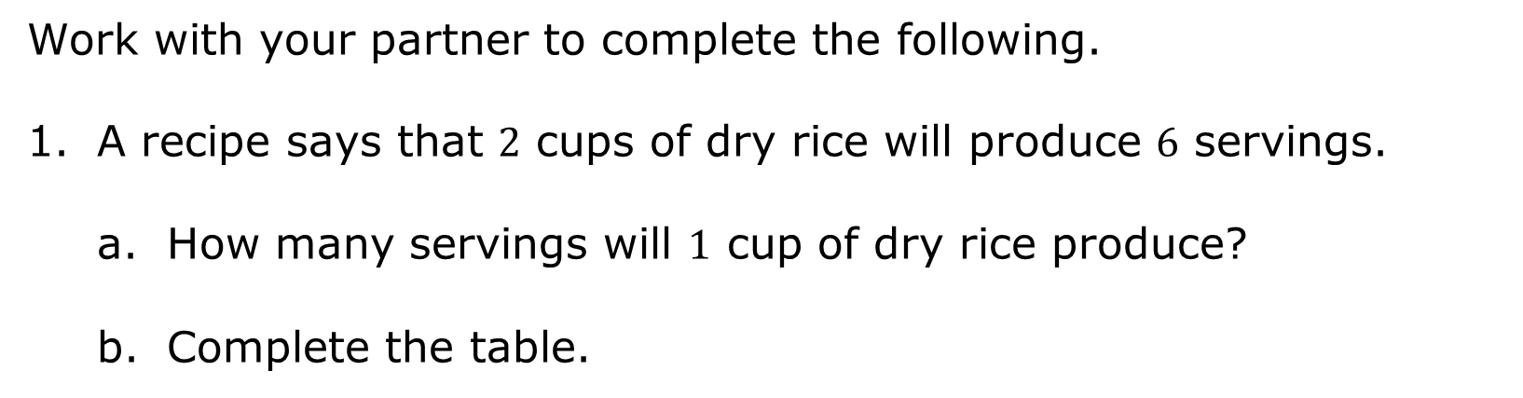
11.6.2 Exploration: Proportional Relationships and Equations
Work with your partner to complete the following.
A recipe says that $2$ cups of dry rice will produce $6$ servings.
How many servings will $1$ cup of dry rice produce?
Complete the table.
Cups of Dry Rice, $x$ | Number of Servings, $y$
$$1$$
$$2$$ | $$6$$
$$3$$
$$12$$
$$43$$
volume 2, pg. 176

Slide 10
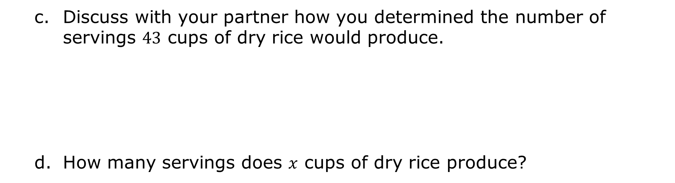
Discuss with your partner how you determined the number of servings $43$ cups of dry rice would produce.
How many servings does $x$ cups of dry rice produce?
volume 2, pg. 176

Slide 11
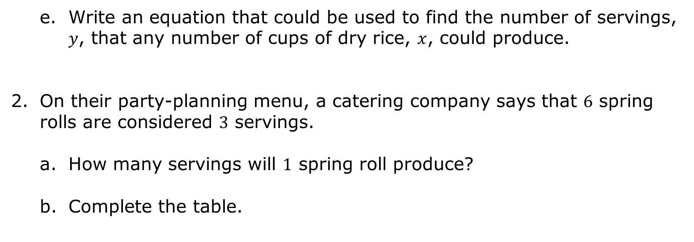
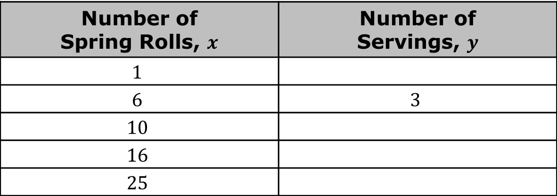
Write an equation that could be used to find the number of servings, $y$, that any number of cups of dry rice, $x$, could produce.
On their party-planning menu, a catering company says that $6$ spring rolls are considered $3$ servings.
How many servings will $1$ spring roll produce?
Complete the table.
Number of Spring Rolls, $x$ | Number of Servings, $y$
$$1$$
$$6$$ | $$3$$
$$10$$
$$16$$
$$25$$
volume 2, pg. 177

Slide 12
With your partner, discuss what was similar and what was different about completing this table when compared with the table in Problem 1b. Summarize your discussion below.
How was completing the tables similar? | How was completing the tables different?
volume 2, pg. 177

Slide 13
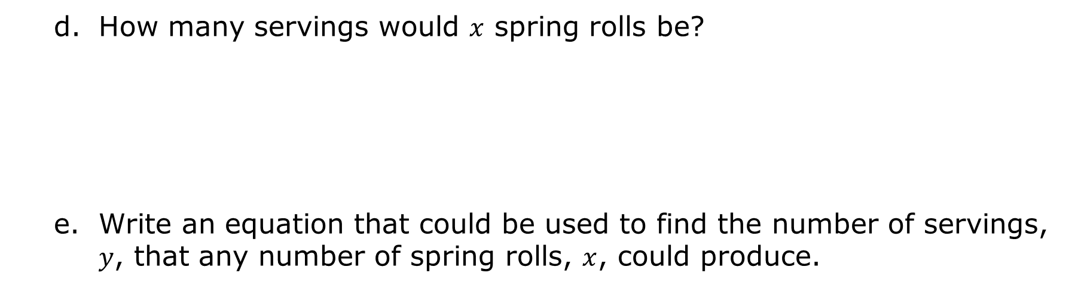
How many servings would $x$ spring rolls be?
Write an equation that could be used to find the number of servings, $y$, that any number of spring rolls, $x$, could produce.
volume 2, pg. 177

Slide 14

Guided Instruction
volume 2, pg. 178

Slide 15

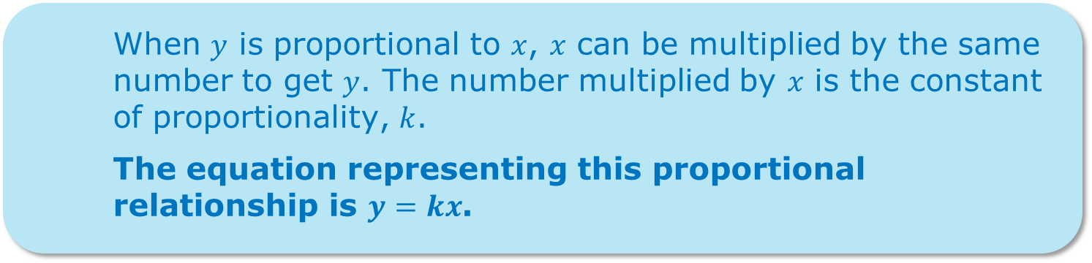
11.6.3 Guided Instruction: Writing Equations to Represent Proportional relationships
In each situation from the Exploration, an equation can be written to represent the relationship.
When $y$ is proportional to $x$, $x$ can be multiplied by the same number to get $y$. The number multiplied by $x$ is the constant of proportionality, $k$.
The equation representing this proportional relationship is $y=kx$.
volume 2, pg. 178

Slide 16
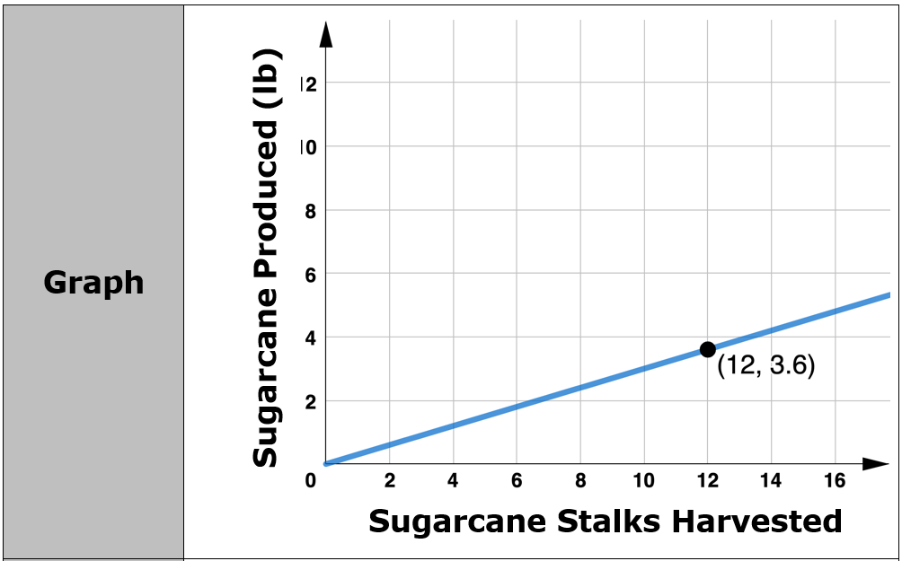
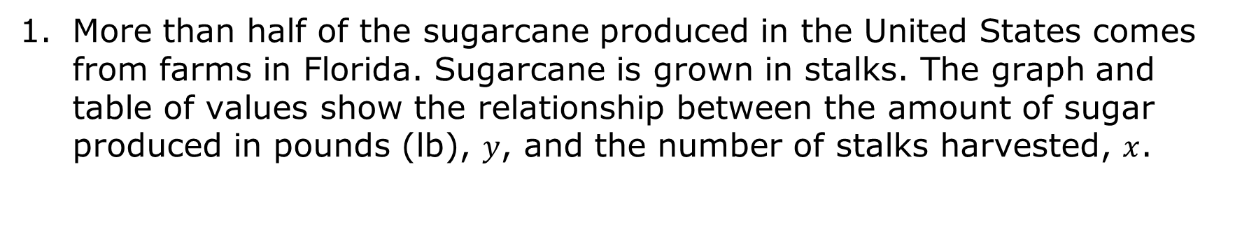
More than half of the sugarcane produced in the United States comes from farms in Florida. Sugarcane is grown in stalks. The graph and table of values show the relationship between the amount of sugar produced in pounds (lb), $y$, and the number of stalks harvested, $x$.
volume 2, pg. 178

Slide 17
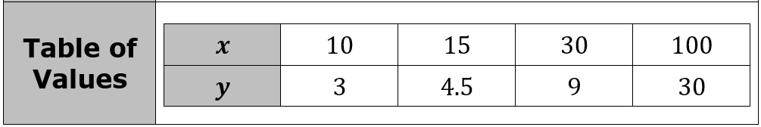
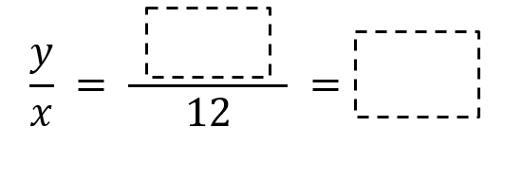
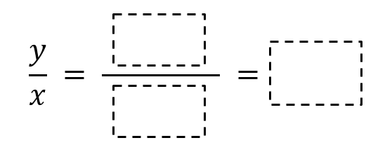
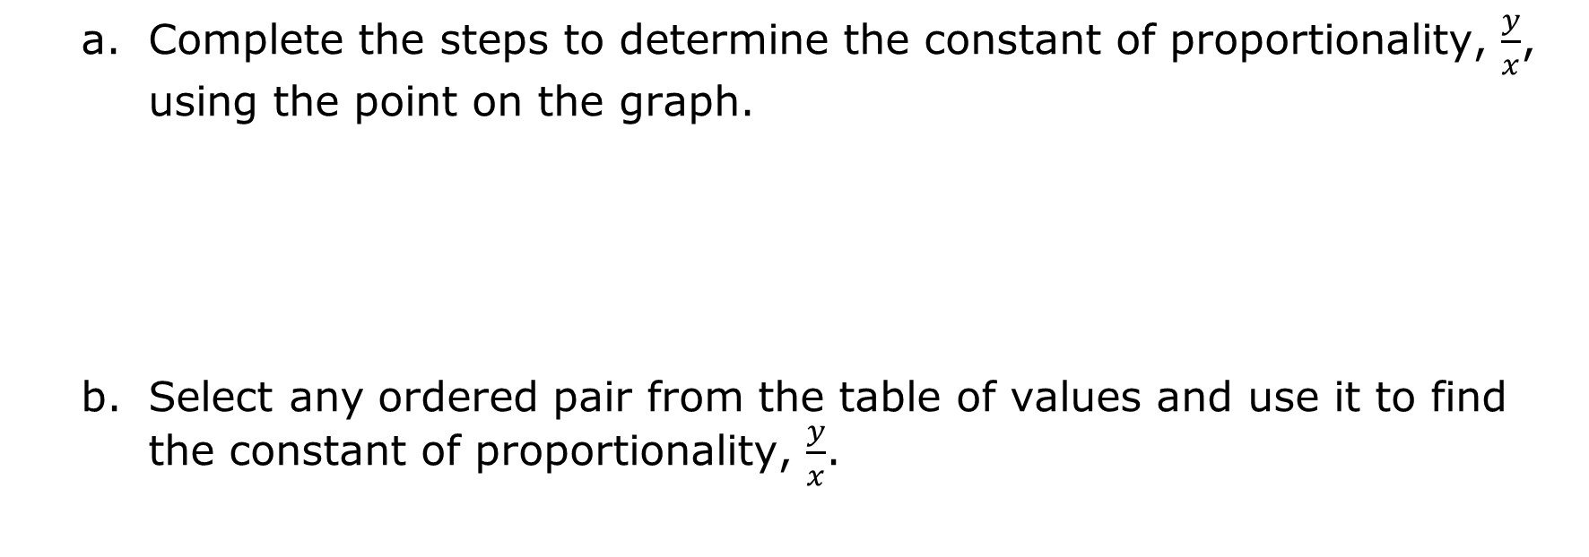
Complete the steps to determine the constant of proportionality, $\frac{y}{x}$, using the point on the graph.
Select any ordered pair from the table of values and use it to find the constant of proportionality, $\frac{y}{x}$.
volume 2, pg. 178

Slide 18
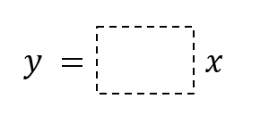
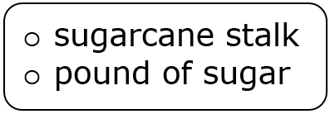
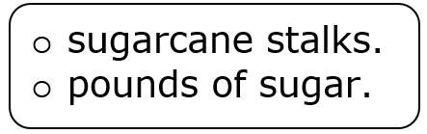
Complete an equation that represents this relationship.
Complete the written description of this proportional relationship.
The average produces _____
volume 2, pg. 178

Slide 19
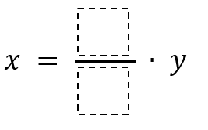
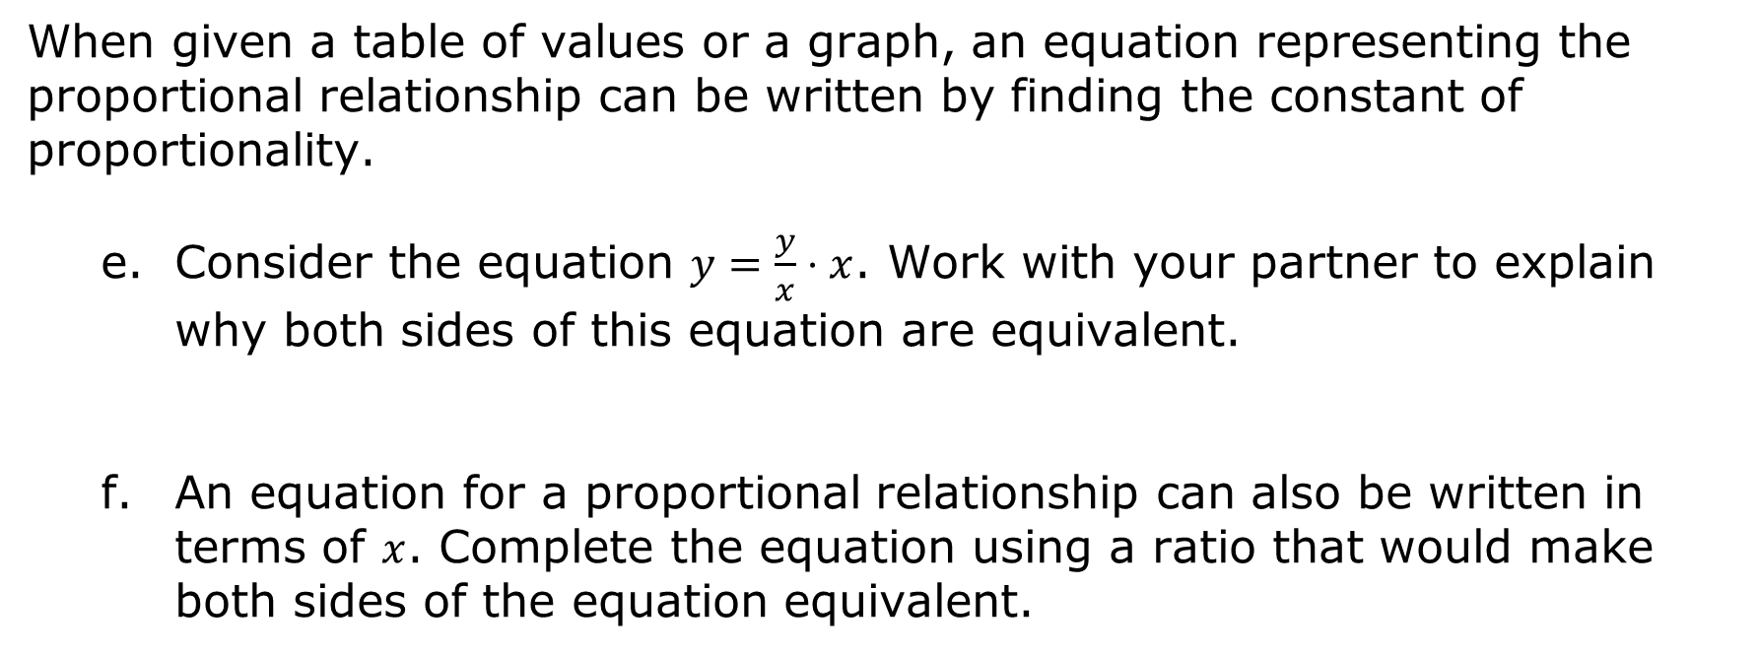
When given a table of values or a graph, an equation representing the proportional relationship can be written by finding the constant of proportionality.
Consider the equation $y=\frac{y}{x}⋅x$. Work with your partner to explain why both sides of this equation are equivalent.
An equation for a proportional relationship can also be written in terms of $x$. Complete the equation using a ratio that would make both sides of the equation equivalent.
volume 2, pg. 179

Slide 20
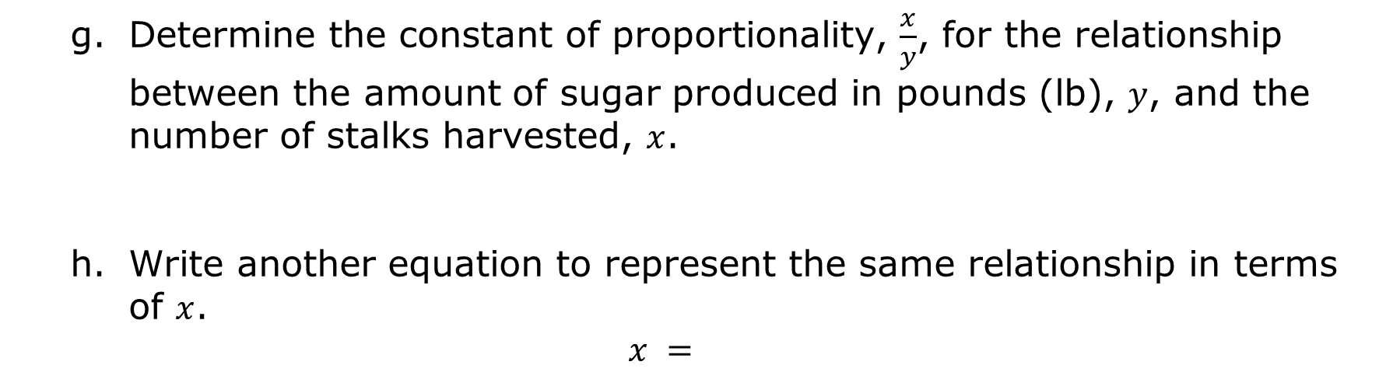
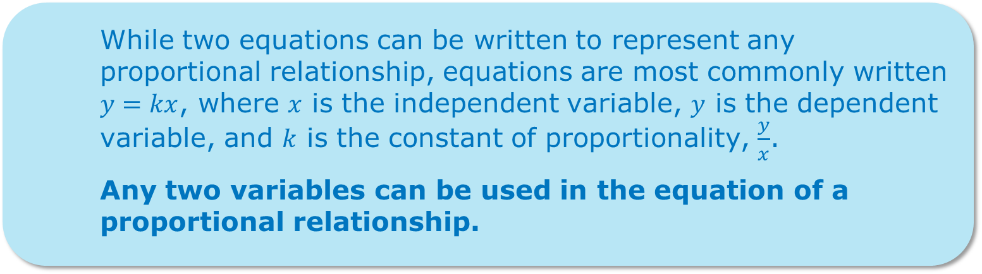
Determine the constant of proportionality, $\frac{x}{y}$, for the relationship between the amount of sugar produced in pounds (lb), $y$, and the number of stalks harvested, $x$.
Write another equation to represent the same relationship in terms of $x$.
$$x =$$
While two equations can be written to represent any proportional relationship, equations are most commonly written $y=kx$, where $x$ is the independent variable, $y$ is the dependent variable, and $k$ is the constant of proportionality, $\frac{y}{x}$.
Any two variables can be used in the equation of a proportional relationship.
volume 2, pg. 179

Slide 21
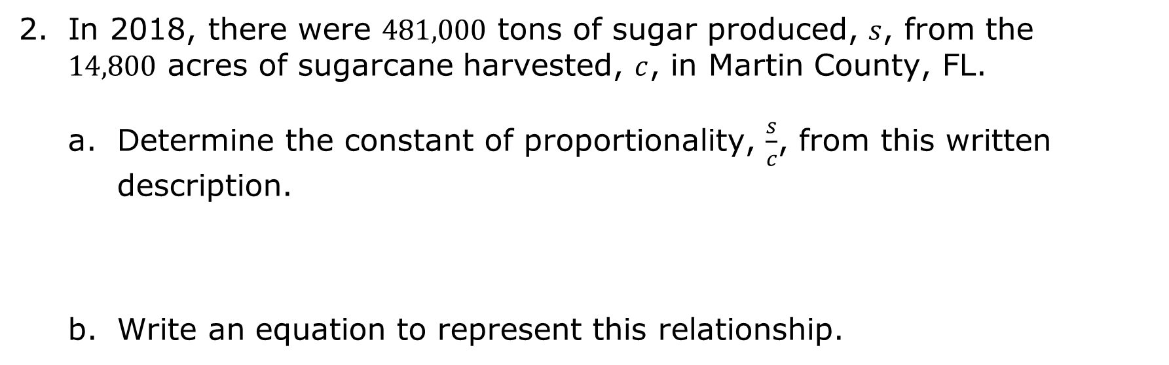
In 2018, there were $481,000$ tons of sugar produced, $s$, from the $14,800$ acres of sugarcane harvested, $c$, in Martin County, FL.
Determine the constant of proportionality, $\frac{s}{c}$, from this written description.
Write an equation to represent this relationship.
volume 2, pg. 180

Slide 22

Guided Practice
volume 2, pg. 180

Slide 23

11.6.4 Guided Practice: Writing Equations to Represent Proportional Relationships
The graph of a proportional relationship is shown.
Write an equation to represent the relationship.
volume 2, pg. 180

Slide 24
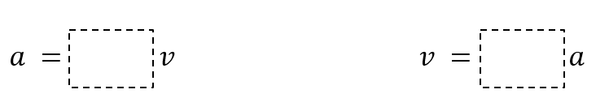
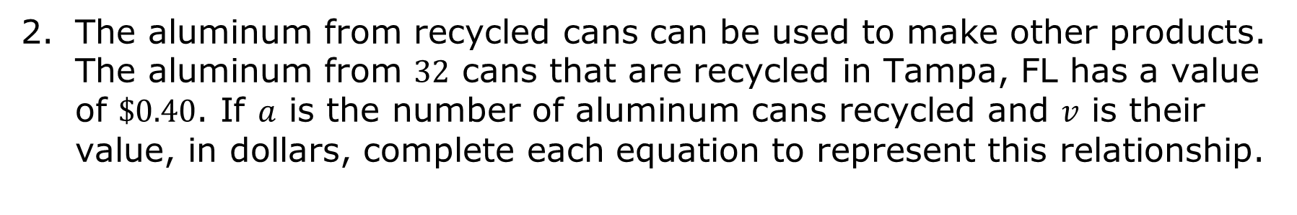
The aluminum from recycled cans can be used to make other products. The aluminum from $32$ cans that are recycled in Tampa, FL has a value of $\$0.40$. If $a$ is the number of aluminum cans recycled and $v$ is their value, in dollars, complete each equation to represent this relationship.
volume 2, pg. 180

Slide 25

Your Turn
volume 2, pg. 181

Slide 26
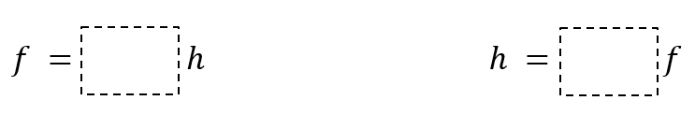
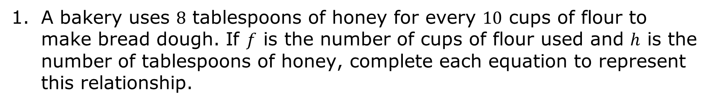
11.6.5 Your Turn!
A bakery uses $8$ tablespoons of honey for every $10$ cups of flour to make bread dough. If $f$ is the number of cups of flour used and $h$ is the number of tablespoons of honey, complete each equation to represent this relationship.
volume 2, pg. 181

Slide 27
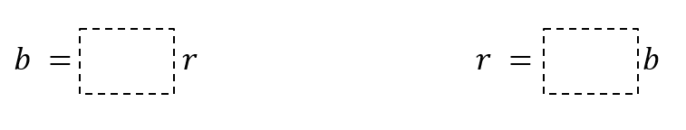

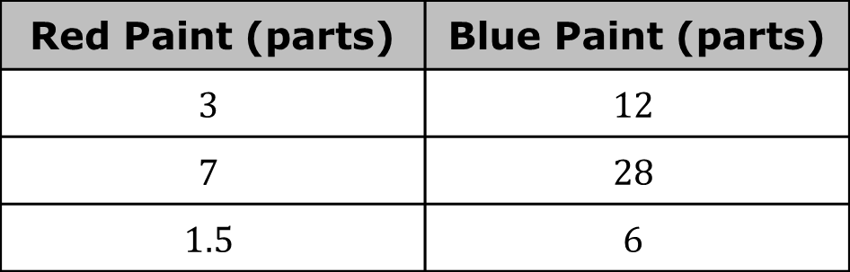
The table shows the amount of red paint and blue paint needed to make a certain shade of purple paint called Venusian Sunset.
If $r$ is the amount of red paint used and $b$ is the amount of blue paint used, complete each equation to represent this relationship.
Red Paint (parts) | Blue Paint (parts)
$$3$$ | $$12$$
$$7$$ | $$28$$
$$1.5$$ | $$6$$
volume 2, pg. 181

Slide 28

Wrap-Up
volume 2, pg. 181

Slide 29
11.6.6 Wrap-Up: Ticket Out the Door
The graph shows the amounts of almonds, in grams, for different amounts of oats, in cups, in a granola mix.
Almonds (grams)
Oats (cups)
volume 2, pg. 181

Slide 30
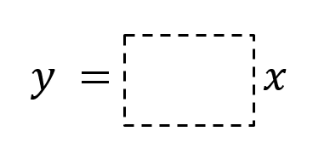
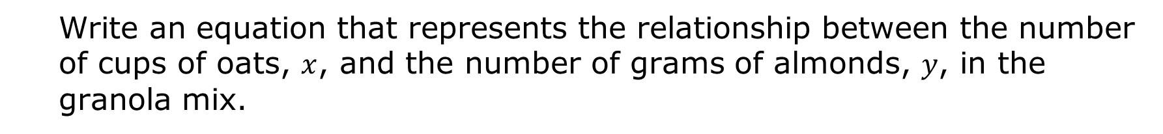
Write an equation that represents the relationship between the number of cups of oats, $x$, and the number of grams of almonds, $y$, in the granola mix.
volume 2, pg. 181

